Slide 1
Integrated Foster Care (IFC)
The Apple Health Foster Care program with HCA, DSHS and Coordinated Care
Created 10/19/17 New Overview Presentation vs1 IMC NC

Slide 2
Integrated Foster Care: Statewide
Who is served
Program & benefits
What’s new for AHCC starting Jan 1, 2019
Who and how to contact
Questions and answers
Notes:
Today we’ll talk about…. Show the Apple Health Core Connections Videohttps://www.coordinatedcarehealth.com/members/foster-care.html
Emphasize STATEWIDE for Foster Care—every county, every region, including the IMC “2020” Regions: Great Rivers, Thurston-Mason, Salish

Slide 3
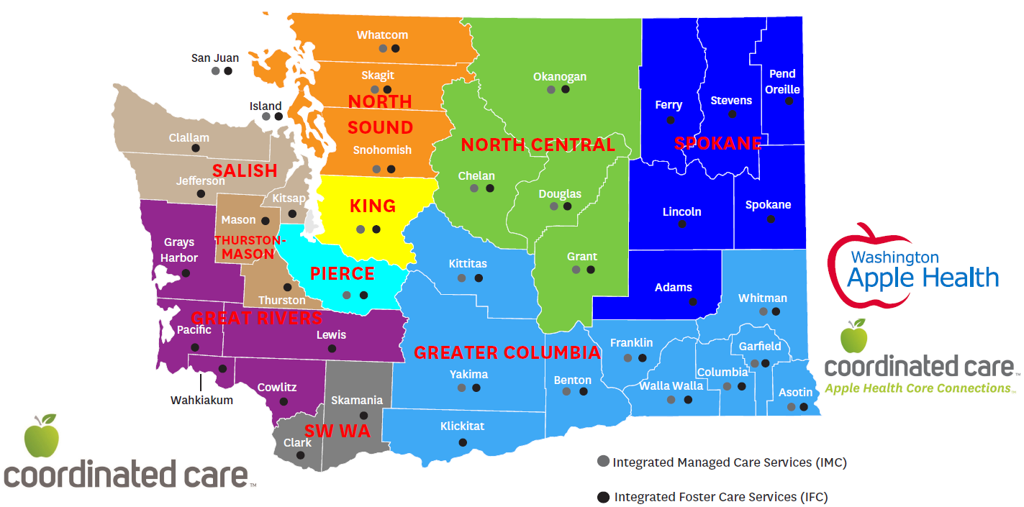
Regional Service Areas

Slide 4
IFC Implementation: IFC RSA Readiness
Greater Columbia
Spokane
Okanogan into NC
Southwest
Pierce
King IPA
North Sound (2019 Transition)
2020 BHO Regions:
Thurston-Mason
Great Rivers
Salish

Slide 5
WISe Planning
Focus on WISe at each AHFC/IFC Integration meeting
CCW Case Management engaged in WISe, full care planning alignment
Convene all MCO WISe Strategy, Jan 2019, quarterly meetings ongoing
Focus on King & NS capacity building (JR referral pathways, new WISe capacity, King WISe forum)
WISe Provider Regional Rounds, check & adjust with WISe/BRS Initiatives
CCW WISe Capacity & Strategy Dashboard

Slide 6
Coverage and Exceptions
Who We Cover:
Exceptions to Enrollment:
33,0000 members
Children/youth in out-of-home placement
Adoption Support
Extended foster care (18-21)
Alumni of foster care
Children/Young Adults…
Placed outside Washington
From another state and not IV-E Eligible
Dual eligible
Voluntary Placement Services program with Developmental Disability Administration (DDA)
Incarceration
Detention facility
Juvenile Rehabilitation (JR)
Private Comparable Medical Insurance
Medical Third Party Liability
In hospice
Apply for Medicaid through WAHealthplanfinder
Notes:
Out-of-home placement /foster care with an open placement in FamLink. Children who have open CA dependency.
Any youth with comparable private insurance will not be enrolled in managed care and will remain in fee-for-service.
NOTES ON AI/AN YOUTH:
Some AI/AN youth were automatically enrolled if their information about tribal affiliation or heritage was not known by Health Care Authority at the time of their enrollment.
American Indian or Alaska Native youth in tribal custody or a Children’s Administration dependency with tribal affiliation
Alumni are eligible through the month of their 26th birthday (so if their birthday is May 13th, they are eligible through the month of May, but not eligible June 1st)
Excluded:
Detention facility, incarcerated coverage is suspended in ProviderOne and with Coordinated Care
Juvenile Rehabilitation (JR) - they are in an institution and are considered incarcerated. They can be there up to age 21.
If they move to JRA process – group homes are included rehab homes 12 beds and less not an incarceration and will be included in Core Connections
All these are fee for service:
If the kid is in foster care and moves into JRA they revert fee-for-service they move out of AHFC RAC into JRA RAC.
Medical third party liability insurance comparable full medical private coverage
Duals ( Medicaid and Medicare )
VPA receive additional help and support so that they can return home Through Developmental Disability Administration (DDA)
In hospice
From other state and not IV-E eligible

Slide 7
Behavioral Health Services Only (BHSO)
Dual Eligibles: Medicaid/Medicare
Third Party Liability (TPL), Comparable Coverage
AI/AN opt-in
Notes:
WHAT IS BHSO, these populations will only receive Behavioral Health services through Coordinated Care and remain Fee-For-Service (FFS) for medical
AI/AN—not auto-enrolled, AI/AN has flexibility to do just BHSO, just Fee for Service or IFC

Slide 8
IFC: On January 1, 2019…
Eligible members are automatically enrolled
New members will receive a Welcome Packet
All members will receive a Welcome Call
During this call we can help:
Confirm a member’s Primary Care Provider (PCP)
Answer benefit questions about Apple Heath Core Connections
Identify health care coordination needs
Get answers to their health and wellness questions
Notes:
Coordinated Care’s name for Apple Health Foster Care program is Apple Health Core Connections.
We have added standardized screening questions around Substance Use and Behavioral Health to support members with their Whole Health needs
All youth entering care will get a Welcome Call within 30 days of their enrollment, and then Coordinated Care will receive their CHET screen
If you are concerned about the validity of the call. Please feel free and hang up and call us back at 1-844-354-9876.
We make 3 attempts at 3 different dates and times to reach you.

Slide 9
Behavioral Health Benefits
Effective Jan. 1, 2019
BHO Access to Care standards ELIMINATED
Low, moderate and high intensity provided by Coordinated Care
Services available from any Coordinated Care provider (*even outside county member lives in)
Members can self-refer
Easier access to outpatient services
Call Coordinated Care for any behavioral health service 1-844-354-9876.
Notes:
Know REGIONAL nuances, understand your audience:
2020 Regions vs King/North Sound vs all other regions
Call out Access to Care in BHO vs standard Access to Care, will give verbiage from provider symposium slide
We offered a contract to every BHO provider, we have a more than adequate BH network and are always interested in contracting with new providers
*stress the fact that there will not be the same regional barriers in finding a provider—or keeping a provider, i.e. if a member moves or changes placement in a neighboring region, they can keep their provider if that works best for them

Slide 10
Behavioral Health Benefits
Wraparound with Intensive Services (WISe)
Program of Assertive Community Treatment (PACT)
Substance Use Disorder Treatment
Outpatient (OP)
Intensive Outpatient (IOP)
Residential
Detox
Opioid Substitution Treatment (OST)
Notes:
Bringing in the ENTIRE continuum of BH benefits—all the BHO level benefits will come to Coordinated Care
Make sure everyone knows what WISe is, know your audience but also ask just in case
PACT is wrap around program mostly used for adults . Keeps people out of the hospital. Many have a co-occurring substance use disorder
Children in BRS cannot be enrolled in WISe—although DCYF is working with HCA on several pilots statewide to explore BRS/WISe collaboration
CLIP and Eastern, Western, Child Study Treatment Center current process
Voluntary CLIP committees continue to exist, BH-ASO will facilitate CLIP committee in each region
Designated Crisis Responders (DCRs), formerly known as DMHPs, control involuntary treatment process for SUD and Mental Health

Slide 11
What about Crisis Services?
Behavioral Health-Administrative Services Only (BH-ASO)
BH-ASO administers crisis services for ALL residents in its defined service area regardless of payment type
Coordinated Care contracts with the BH-ASO to administer crisis services on behalf of our members
9 regional crisis lines

Slide 12
BH-ASO Responsibilities
State-funded services for Non-Medicaid beneficiaries
County-funded services for Medicaid and Non-Medicaid
Miscellaneous
BH Ombudsman
Committees formerly led by BHO (RSN) – WISe, CLIP, BH Advisory Board, FYSPRT, etc.
Includes DCRs
Crisis services for all members of the community
24/7 Crisis Line
Regional Crisis numbers

Slide 13
AHCC Program Objectives
Whole-person health across our System of Care (SOC)
Integrated physical and behavioral coordination
Trauma-Informed, recovery-focused
Establish a PCP and medical home
Increase access: right care, right time
WISe, behavioral, preventive and specialist
Best practices and EBPs
Notes:
Trauma-Informed and Recovery-Focused: Reference that all of this is part of our System of Care (will present in a later slide), ok to go into detail about each of these, take a little more time on this slide
Whole-person care, including social determinants of health
Collaboration early, often with providers and allied health systems
In-person technical assistance that works best for the community
Trauma-informed care
Patient-centered care teams
Capacity Building: train system of care providers and stakeholders, leverage and increase delivery Evidence Based Practices (EBPs)—use examples, Parent Child Interactive Therapy (PCIT), Trauma-Focused Cognitive Behavioral Treatment (TF-CBT), Positive Parenting Program (Triple P)
Metrics to discuss (aligned with CFSR metrics):
Increase preventative care/well-visits (HEDIS)
Improve health and pharmacy data access
Decrease emergency room use
Decrease inpatient admissions
Decrease suicide ideations/attempts, self-harm, overdose
Improve overall health and well-being

Slide 14
Whole-Person Healthcare
Supporting physical, behavioral health and social services with:
Aligned and integrated care
Support/services to meet member‐determined goals
Communication and links between the member’s medical home and other care/service needs
Focused on prevention
Outreach with providers, members and community partners grounded by four core values of our System of Care

Slide 15
Notes:
Our System of Care Model
Provider Partnership Unit:
Allied Systems: paid professionals in systems outside of healthcare schools, jails,
Community supports, non profits, churches, sports
Crisis Systems of Care Liaison -
Children’s Behavioral Health Systems of Care Liaison
Substance Use Disorder Systems of Care Liaison
Health Equity Liaison
Tribal Liaison—Sheryl Lowe is Director of Tribal Affairs
Core Values:
Focused on the whole-person
Recovery-oriented
Culturally responsive
Self-determined

Slide 16
SOC Core Values
MEMBER
Focused on the Whole-Person
The head is connected to the neck.
Social Determinants of Health drive health outcomes.
Coordinated Care works to wrap care around the member based on the intensity of all of their needs.
Recovery Oriented
How do we instill recovery?
Our job is to help people know they are not their illness.
People can find meaningful lives despite their conditions (physical and/or behavioral)
Culturally Responsive
Coordinated Care makes active efforts to ask members about their identities across multiple dimensions.
Coordinated Care provides culturally and linguistically appropriate services in response to a member’s self-identification.
Self-Determined
The patient is the “driver” of their goals and integrated care plan.
Engaging the member with goals that matter to them

Slide 17
Our Goal: Make it easier
Care Coordination team:
Assists case workers and caregivers
Ensures timely access to needed physical and behavioral health services
Results in…
Improved functional health outcomes
Fewer placement/treatment disruptions
Prescription medication oversight
Improved school performance
Member/caregiver satisfaction
Delivery of best practices
Population Health- based program design
Notes:
You are the expert in protecting children and families, our partnership allows us to relieve you of worrying about the child’s health because we are the health care expert, we have the accountability of ensuring all health care needs are met and knowing what the health conditions are and treatments needs required, which allows the you, the social worker, an additional resource for answering questions about health conditions and diagnosis, information to include when writing court reports on the child’s progress, etc.
Children’s Administration is currently focused on children receiving the services they need to meet their physical and mental health and Coordinated Care is here to support this effort.
Examples of how this program supports Safety, Permanency and Well-being
Improve access by ensuring all children entering the foster care system have a designated primary care provider, confirming they have received their health care examinations timely and assist in coordinating care for any follow up recommendations.
Improve coordination of services by assessing all children upon entering the health plan and providing coordination and clinical support based on the child’s individual health care needs.
Support improvement of functional outcomes… by ensuring caseworkers and families have the information they need about the child’s health condition/diagnosis.

Slide 18
Integrated Care Coordination (ICC) Teams:
Care Coordination & Management
Traffic control in the System of Care
Data to inform risks, care gaps, under or over utilization
Blended disciplines, include reps from member’s System of Care:
Community‐based partner organizations and allied agencies
Monitor daily reports from after-hours calls transferred to Regional Crisis/ASO line
Notes:
-under or over utilization: examples
-ICC Care Coordinator Health Care Coordination Teams staffed by:
Behavioral Health Care Managers
Nurse Care Managers
Health Care Social Workers
Program Coordinators
-ICC Team members facilitate same‐day outreach to assist the member with scheduling an appointment with a provider most appropriate to the member’s clinical needs
-Give examples of why they should call Care Coordination (translate to audience)
-ICC team members will meet with the member where they are at in the community to support their needs

Slide 19
Accountability & Transparency
Contacts:
Health Care Authority (HCA) Contract Manager: Sylvia Soto (360) 725-1517 HCAMCPrograms@hca.wa.gov
Apple Health Core Connections Manager, Operations:
Julie Lowery (253) 278-9279 Julie.Lowery@coordinatedcarehealth.com

Slide 20
Keeping You Updated
CoordinatedCareHealth.com/AppleHealthCoreConnections
Medicaid Events (Community meetings, trainings, webinars) https://www.coordinatedcarehealth.com/members/foster-care/medicaid-events.html
AHCC Liaisons work directly with DSHS staff and help facilitate issue resolution and training needs.
AHCC Community Educators provide ongoing program education and support across the state.
Notes:
Add link to provider manual?

Slide 21
Need More Information?
Apple Health Core Connections:
1-844-354-9876
Save this number in your phone.
HCA Foster Care Medical Team (Eligibility and Enrollment) 1-800-562-3022 ext. 15480 FCMT@hca.wa.gov

Slide 22
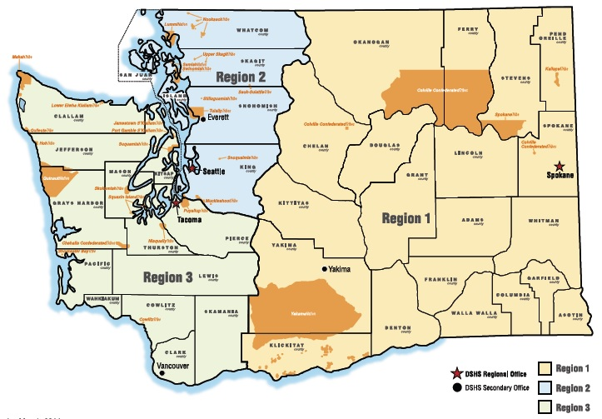
Community Educators
Manager/Region1: Jennifer Barron
Jennifer.L.Barron@coordinatedcarehealth.com
206-701-1192
Region 2: Lindsey Greene
Lindsey.C.Greene@coordinatedcarehealth.com
206-200-4902
Region 2: Heather Perry
Heather.R.Perry@coordinatedcarehealth.com
206-200-4389
Region 3: Kathleen Page
Kathleen.D.Page@coordinatedcarehealth.com
253-348-0300
Region 1: Zia Freeman
Zia.F.Freeman@coordinatedcarehealth.com

Slide 23
AHCC Liaisons
Region 1: Joey Charlton
509-317-1064 JoCharlton@coordinatedcarehealth.com
Region 2: Jen Estroff
206-492-9019 JEstroff@coordinatedcarehealth.com
Region 3: Julie Lowery
253-278-9279 Julie.M.Lowery@coordinatedcarehealth.com
Apple Health Core Connections Liaisons are assigned to each region to make certain that Children’s Administration staff have on-going support in the program. Liaisons are focused on effective communication between DSHS, Coordinated Care, members, foster parents and medical providers.

Slide 24
Thank You!

